Slide 1
Сертификация Commvault
18.02.2026

Slide 2
Экзамены
Commvault Professional
Certified Engineer - Command Center
Certified Engineer - CommCell Console
Advanced Configuration - CommCell Console
Certified Expert - CommCell Console
2 попытки
You will have two attempts at passing the exam, please note that there is a 24-hour waiting period between the two attempts.
Сайт: https://www.readiverse.com/academy

Slide 3
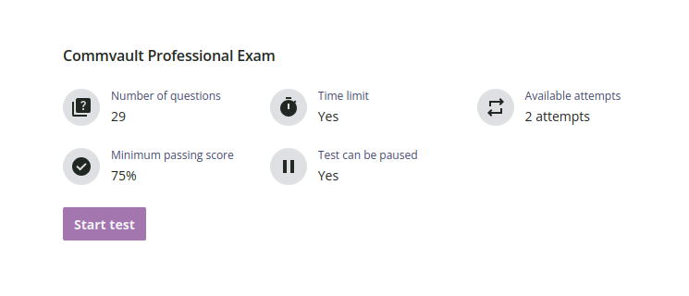
Commvault Professional
Commvault Professional Self-Paced Course for Partners & Employees (eLearning Videos & Exam)
Видео (2-3 часа)
Экзамен (1 - 1.5 часа)
Основа для всех последующих экзаменов

Slide 4
Примеры вопросов
A disk storage target mount path can be defined by which of the following?
  - Local path (for local disks or SAN attached disks)
  - UNC path
  - Mapped network drive
  - All of the above
Which of the following statements regarding operational controls is true?
  - Enabling data protection at a child level will always override CommCell level settings.
  - Enabling data protection at the CommCell level will automatically enable data protection at all child levels.
  - Operation controls can only be configured at the subclient level.
  - Disabling data protection at the CommCell level will disable data protection at all child levels

Slide 5
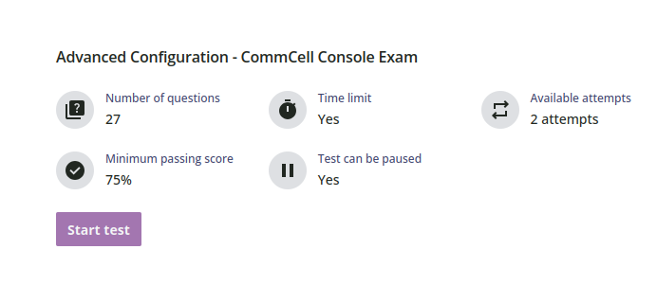
Advanced Configuration - CommCell Console
Advanced Configuration - CommCell Console Self-Paced Course for Partners & Employees (eLearning Videos & Exam)
Видео (5 часов)
Экзамен (1 - 1.5 часа)
It is highly recommended that you pass the Professional Advanced exam before registering for this exam.

Slide 6
Примеры вопросов
Which option allows you to retain data longer than the defined retention, given that there is enough free space in the disk library?
    - Managed Disk Space Thresholds
    - Low Watermark
    - High Watermark
    - Extended Retention
You are troubleshooting an active job. You want to view the Events Viewer tab and the Job Controller tab side-by-side. What is the easiest way to do this?
  - Right-click one of the tabs and select split. On one of the split screens, select the second tab.
  - Right-click one of the two tabs and select Float. Move the floating window to the side or to a second screen.
  - Open a second instance of the CommCell Console. For each instance, bring one of the two views in the foreground. Move one of the instances to the side or on another screen.

Slide 7
Certified Engineer
Command Center & CommCell Console
2 экзамена
Вопросы повторяются
It is highly recommended that you pass the Professional Advanced exam before registering for this exam.
To achieve Commvault Engineer Certification you must first complete the Commvault Professional Certification.

Slide 8
Примеры вопросов
What is the optimal block size for formatting a SAN or DAS disk library volume connected to Windows MediaAgent?
    - 4KB
    - 64KB
    - 128KB
    - 512KB
You have applied Commvault’s Deduplication feature in a new installation of Commvault software. What is the default order of processes when backing up database data using the appropriate Commvault agent?
  - Compression, signature generation, but data cannot be encrypted
  - Signature generation, compression, and optional encryption
  - Compression, signature generation, and optional encryption
  - Signature generation, compression, but data cannot be encrypted

Slide 9
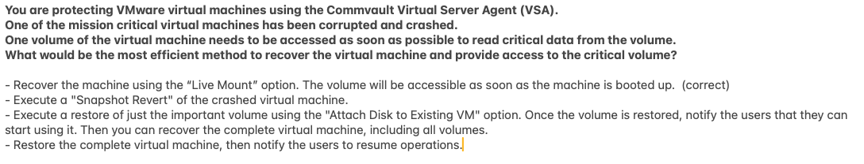
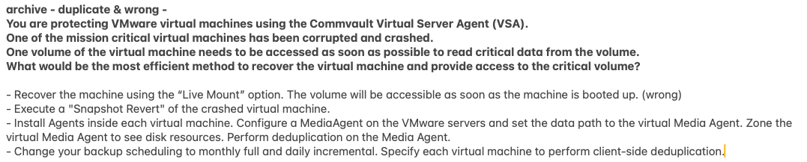
Подводные камни

Slide 10
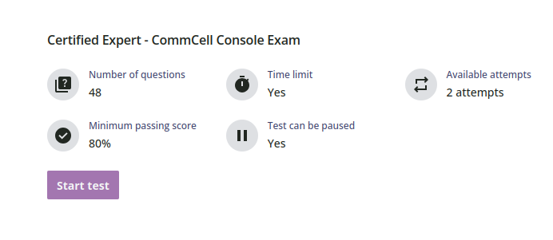
Certified Expert - CommCell Console
3 часа
It is highly recommended that you pass the Certified Engineer exam before registering for this exam.
To achieve Commvault Expert Certification you must first complete the Commvault Engineer Certification.

Slide 11
Примеры вопросов
Which of the following is not a data pruning method involved in aging out deduplicated data?
  - SFILE expiration.
  - SFILE deletion.
  - SFILE truncation.
  - Drill holes.
Which of the following commands can best help in troubleshooting multi-stream tunneling issues? Choose the best answer
  - Telnet
  - cvipinfo IPv4
  - cvping
  - netstat -anob

Slide 12
Hi, I'm Arlie, your AI assistant.

Slide 13
Дополнительные материалы
Commvault Command Center: Architecture & Troubleshooting – CPR2024
  1 - 1.5 часа
Методички на files.jet.su
  https://tools.jet.su/files/index.php?p=Commvault%2FCourses%2FCommvault+Engineer
  https://tools.jet.su/files/index.php?p=Commvault%2FCourses%2FCommvault+Professional
  https://tools.jet.su/files/index.php?p=Commvault%2FCourses%2FCV+Professional+Advanced
  https://tools.jet.su/files/index.php?p=Commvault%2FCourses%2FCommvault+Expert

